Slide 1

“Cyber Threat Analytics Platform with Incident Visualization System ”
Group 1 Batch 1
Infosys Virtual Internship 7.0
Presented By: Harini T
Mentor: Mrs. Nithayasri S J
Internship Duration: 8 weeks | Year: 2026

Slide 2




Project Objectives
Cyber Threat Detection
Threat Pattern Analysis
Analyze real-world network data to identify malicious activity and intrusion attempts.
Study attack trends, protocols and traffic behaviour to uncover recurring threat patterns.
Security Data Visualization
Actionable Security Insights
Transform raw cybersecurity logs into clear, interactive Power BI dashboards.
Deliver insights that support faster, more informed security decision-making.

Slide 3






Project Description
An end-to-end cybersecurity analytics project covering data collection through to threat visualization and insight generation.
Module 1: Data Collection
Module 2: Data Loading
Module 3: Data Understanding
Gathered the raw cybersecurity threat detection dataset from Kaggle.
Imported and connected the dataset into Power BI for analysis.
Explored dataset structure, features and target columns in depth.
Module 4: Data Preprocessing
Module 5: Dashboard Development
Module 6: Threat Analytics & Insights
Applied a 12-step pipeline to clean and prepare analysis-ready data.
Built a 7-page interactive Power BI threat analytics dashboard suite.
Derived actionable security insights from visualized threat patterns.

Slide 4
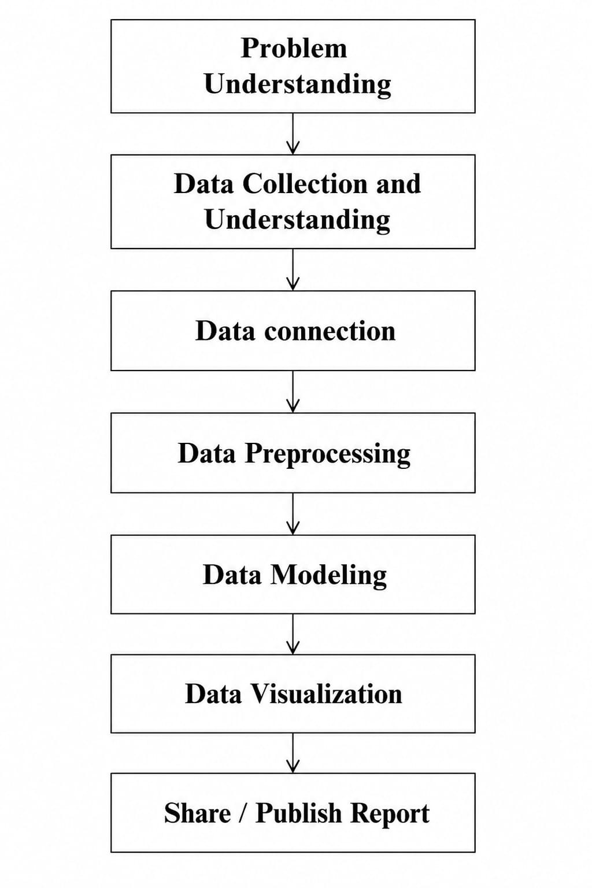
Workflow Diagram

Slide 5



Top Visualizations & Components Used
Visual Type
Purpose
KPI Cards
Highlight key totals like total logs, % traffic blocked and total data volume.
Pie Chart
Show proportional split of incidents across categories such as log type.
Donut Chart
Break down protocol or traffic type share with a compact circular view.
Bar Chart
Compare threat counts or breach volumes across categories.
Column Chart
Display trends and rankings such as severity levels side by side.
Line Chart
Track threat log volume and traffic trends over time.
Slicers / Filters
Enable interactive filtering of dashboards by protocol, date or type.

Slide 6
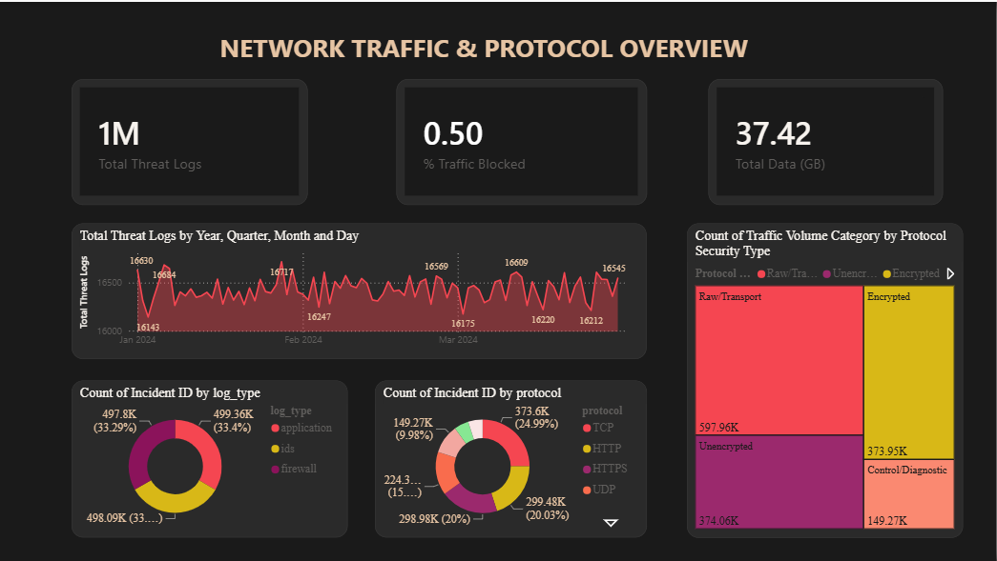
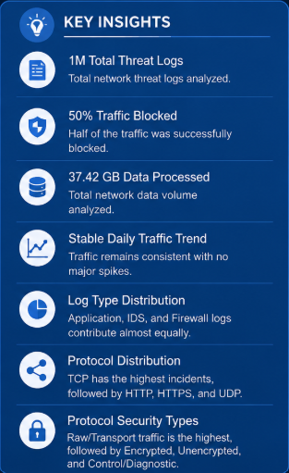
DATA VISUALISATION • DASHBOARD 1 OF 7
Network Traffic & Protocol Overview

Slide 7
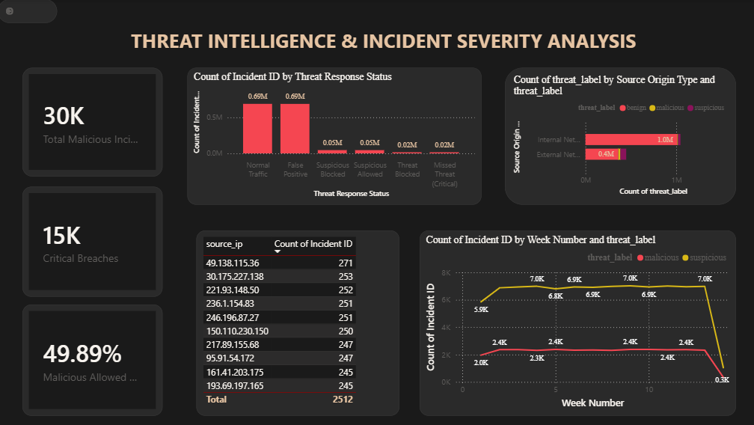
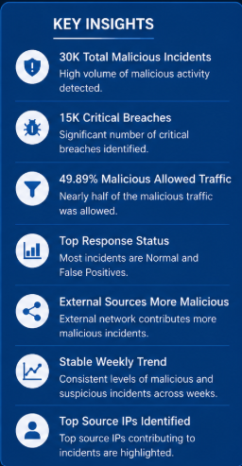
DATA VISUALISATION • DASHBOARD 2 OF 7
Threat Intelligence & Incident Severity

Slide 8
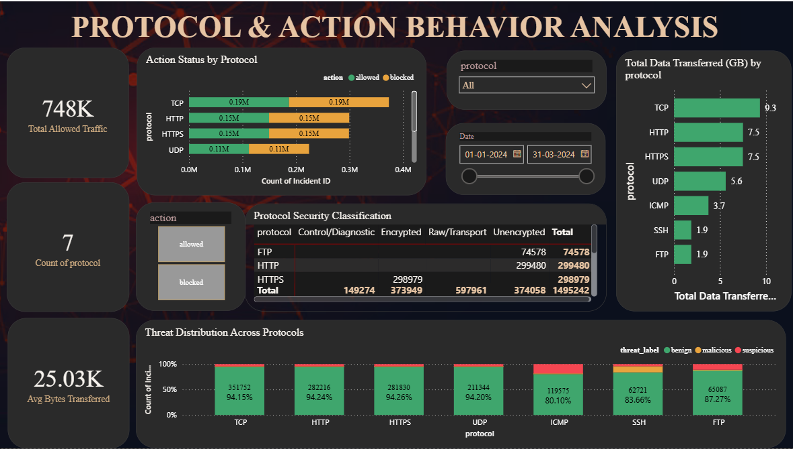
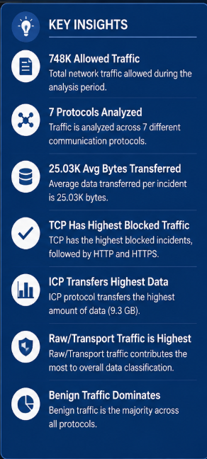
DATA VISUALISATION • DASHBOARD 3 OF 7
Protocol & Action Behaviour Analysis

Slide 9
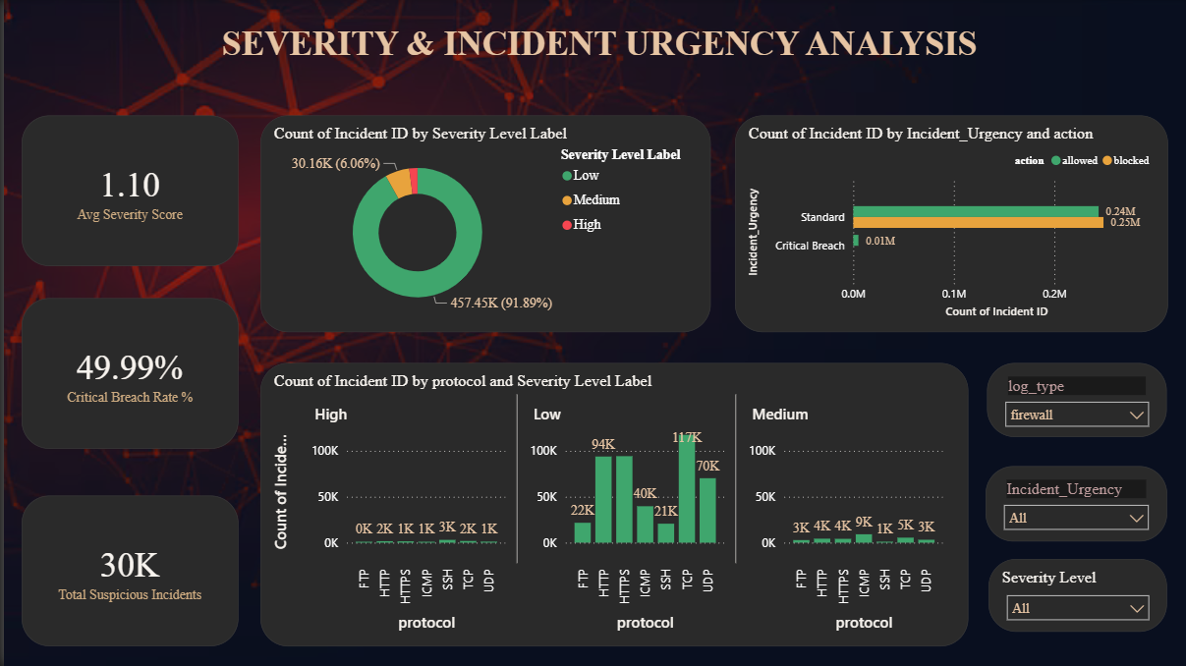
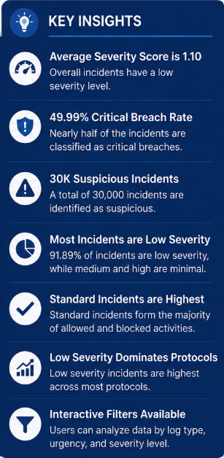
DATA VISUALISATION • DASHBOARD 4 OF 7
Severity & Incident Urgency Analysis

Slide 10
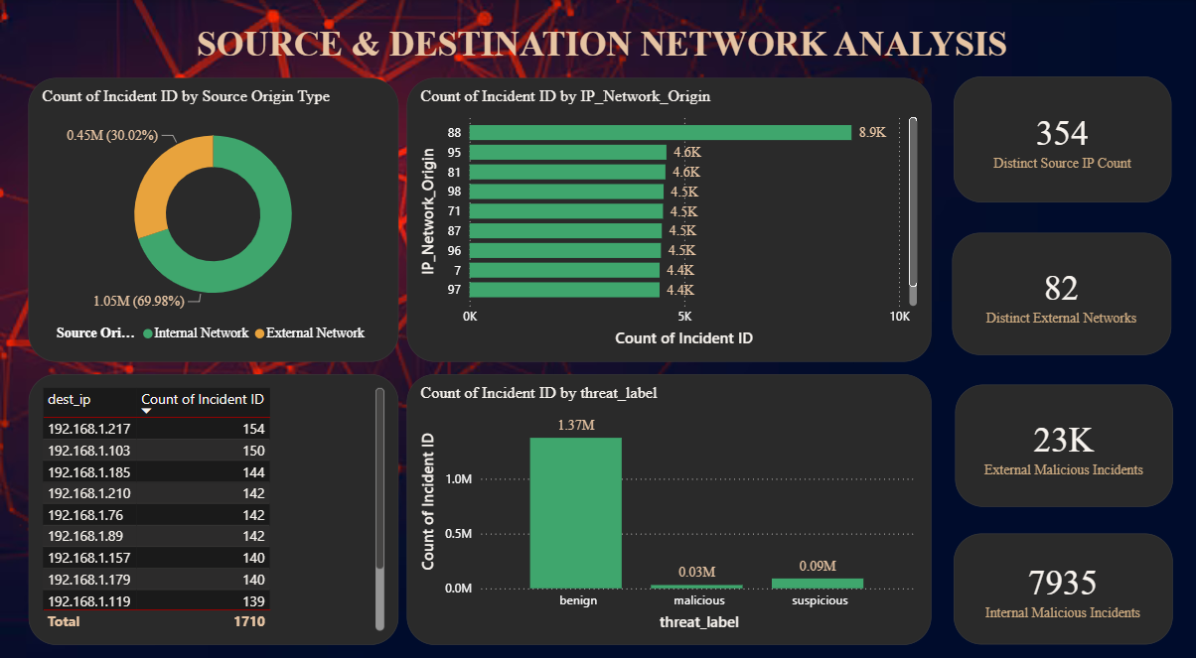
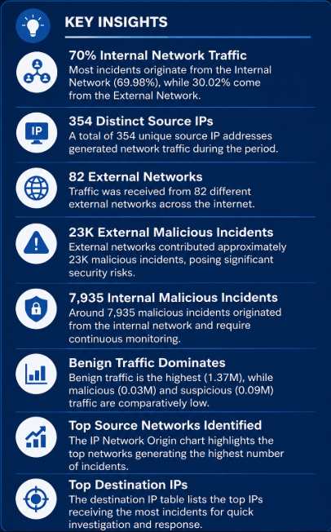
DATA VISUALISATION • DASHBOARD 5 OF 7
Source & Destination Network Analysis

Slide 11
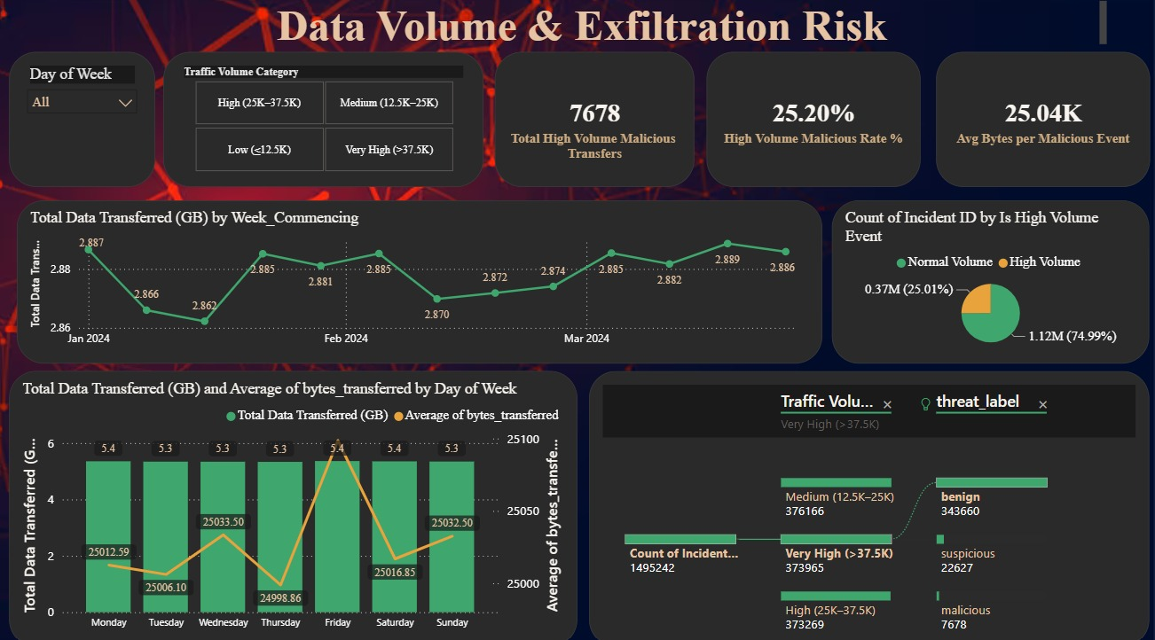

DATA VISUALISATION • DASHBOARD 6 OF 7
Data Volume & Exfiltration Risk
KEY INSIGHTS
7,678 High-Volume Transfers
Malicious transfers in the high traffic band.
25.20% Malicious Rate
Share of high-volume traffic that is malicious.
25.04K Avg Bytes / Event
Average bytes per malicious event.
Stable Weekly Volume
Transfers stay steady near 2.86–2.89 GB.
Mostly Benign Traffic
Malicious traffic is a small minority overall.

Slide 12
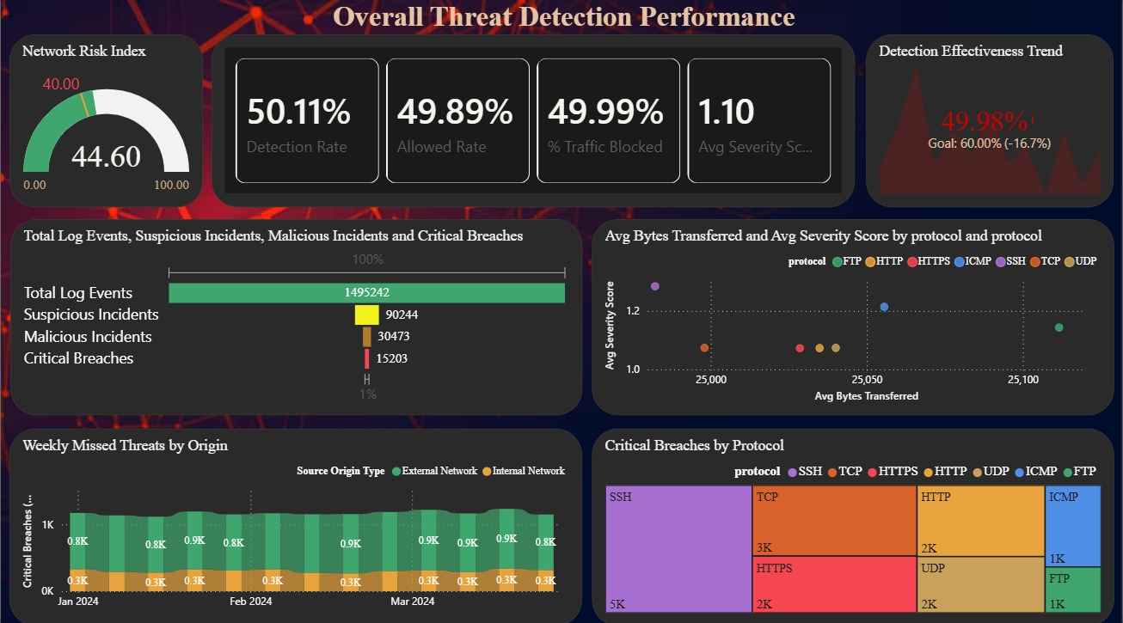

DATA VISUALISATION • DASHBOARD 7 OF 7
Overall Threat Detection Performance
KEY INSIGHTS
44.60 Network Risk Index
Above the 40 threshold — elevated risk level.
50.11% Detection Rate
Just over half of all traffic is detected.
49.99% Traffic Blocked
Nearly half of all traffic is actively blocked.
1.49M Log Events
Total events, incl. 15,203 critical breaches.
SSH Leads Breaches
SSH has the highest share of critical breaches.

Slide 13


Project Execution Milestones
Dataset Used: Cybersecurity Threat Detection Logs
Milestone 1: Dataset Collection & Understanding
Collected the raw cybersecurity dataset from Kaggle and explored its structure, features and target columns.
Milestone 2: Initial Dashboard Development
Developed the first 2 interactive Power BI dashboards. Analysed key cybersecurity threat patterns and incident trends.
Milestone 3: Dashboard Expansion & Analysis
Developed 3 additional dashboards, bringing the total to 5 dashboards. Improved threat, severity, attack-status and incident analysis.
Milestone 4: Final Dashboard Development & Integration
Developed the remaining 2 dashboards, completing the full 7-dashboard suite. Integrated all dashboards into a consistent interactive framework..

Slide 14


Challenges Faced and Resolutions
Challenge
Resolution
Large Dataset Handling
Applied data optimization and structured preprocessing techniques.
600,000 records required efficient handling for smooth analysis.
Challenge
Resolution
Data Quality Issues
Performed cleaning, missing value handling and duplicate removal.
Raw logs contained missing values, duplicates and inconsistencies.
Challenge
Resolution
Meaningful Dashboard Design
Used interactive Power BI visuals, KPIs and clear layouts.
Presenting complex threat data clearly was difficult at first.

Slide 15



Learnings & Skills Acquired
Technical Skills
Soft Skills
Power BI
Team Collaboration
Data Preprocessing
Problem Solving
Data Visualization
Analytical Thinking
Cybersecurity Analytics
This internship strengthened both my technical foundation in data analytics and my ability to collaborate and think critically under real project constraints.

Slide 16





Future Enhancements
Future Enhancements
KEY INSIGHTS
Real-time threat monitoring
Effective threat visibility
Predictive threat analytics
Faster decision-making
Machine learning integration
Automated alert system
Improved security monitoring

Slide 17
Conclusion
Successfully analyzed cybersecurity threat data as an individual project contribution.
Built a complete 12-step data preprocessing workflow from raw logs to analysis-ready data.
Developed a 7-page interactive Power BI dashboard suite for threat visualization.
Generated actionable security insights to support faster decision-making.
Gained hands-on, practical experience in cybersecurity analytics and data visualization.

Slide 18




Acknowledgements & References
Acknowledgements
References
Infosys Springboard, for the internship opportunity
Kaggle — Cybersecurity Threat Detection Logs Dataset
Mrs. Nithayasri S J, Project Mentor
Microsoft Power BI Documentation
Team A members-Akshay Jaiswal,Darsh Dwivedhi,Hemanth M for their collaboration
Cybersecurity Analytics Resources
Internship Coordinators, for their continued support

Slide 19
Thank You

